Slide 1
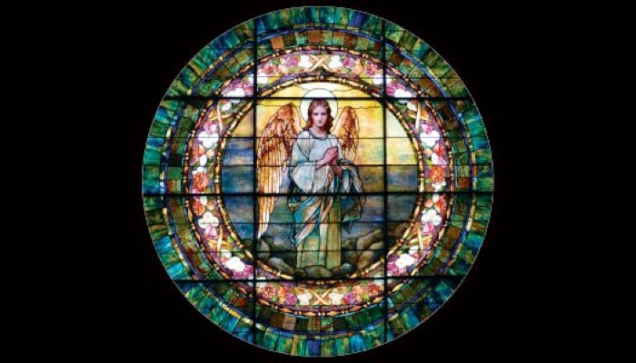
Trinity Parish
﻿The Episcopal Church
in Oshkosh, Wisconsin
A Christian community of worship,
connection, growth, and service.

Slide 2
Agenda September 9, 2018
Welcome from Father Chris
Welcome from Senior Warden
Lunch Service
Review of the Vestry’s Findings
Assignment of Discussion Groups
Group Discussions
Reports from Group Discussions
Plenary Discussion and Consideration of All Six Values
Voting
Closing Remarks

Slide 3
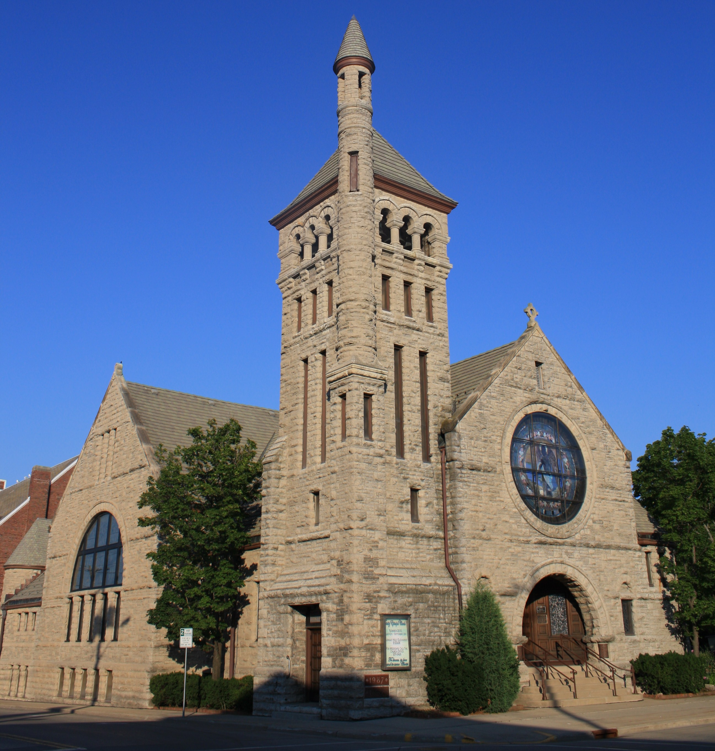
Who are we?
Who do we want to be?
What is the Holy Spirit calling
us to do in/for our
communities?
What mission or value
will enable us to stand
out in the Oshkosh
community?
Notes:
Towards which value is Trinity being led? Which one value would help us stand out in the community?

Slide 4
The Six Values
1. Education
2. Liturgy & Worship
3. Ministry to/with Older People
4. Outreach / Social Justice Ministry
5. Pastoral Care & Fellowship
6. Youth

Slide 5
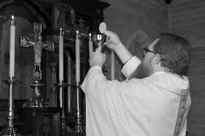
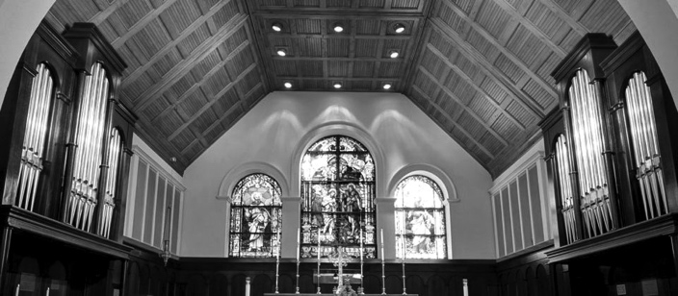
The Six Values
1. Education
2. Liturgy & Worship
3. Ministry to/with Older People
4. Outreach / Social Justice Ministry
5. Pastoral Care & Fellowship
6. Youth

Slide 6
The Five Values
Education
Ministry to/with Older People
Outreach / Social Justice Ministry
Pastoral Care & Fellowship
Youth

Slide 7
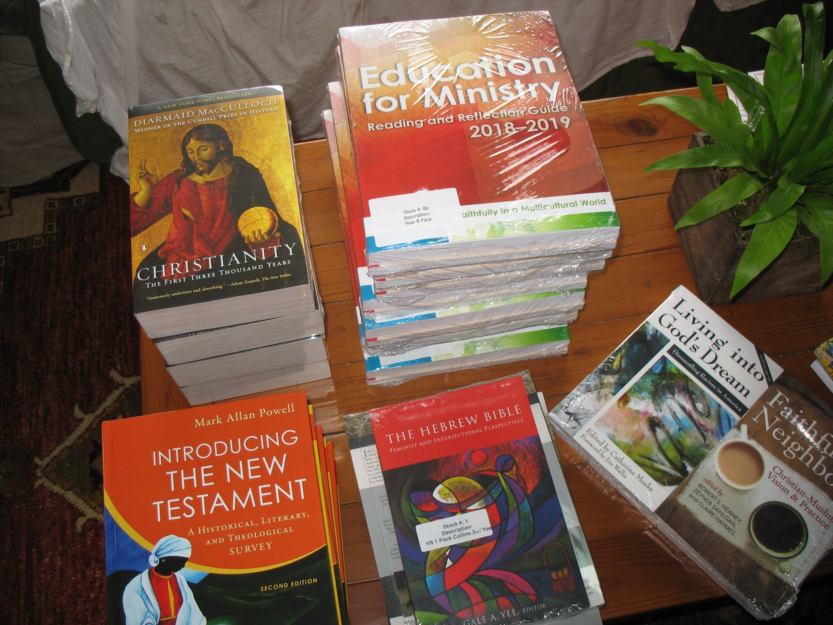
^{Education}
“Do not be conformed to this world, but be transformed by the renewing of your minds, so that you may discern what is the will of God—what is good and acceptable and perfect.” Romans 12:2
What are we doing now?
What needs/opportunities
have we identified?

Slide 8
Education

Slide 9
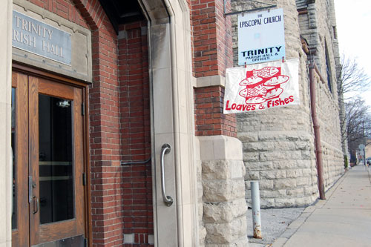
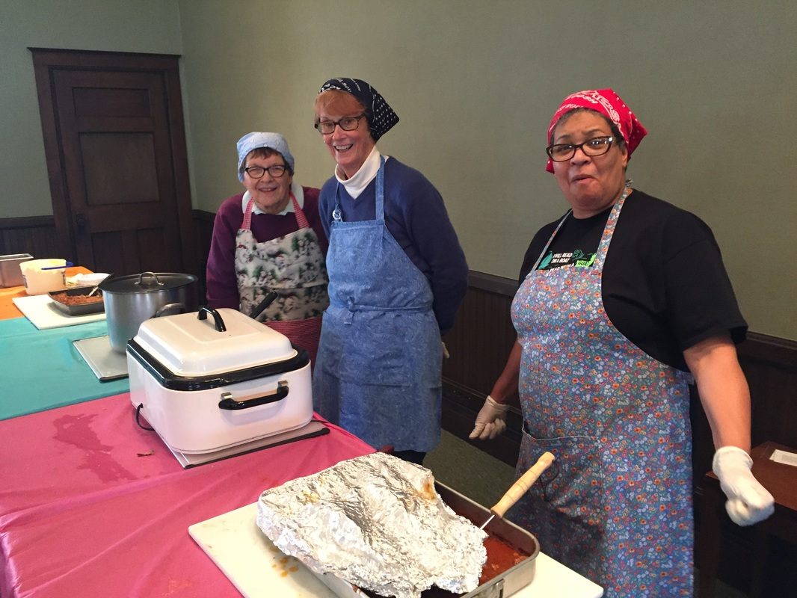
^{Outreach / Social Justice} ^{Ministry}
“Like good stewards of the manifold grace of God, serve one another with whatever gift each of you has received.” 1 Peter 4:10
What are we doing now?
What needs/opportunities
have we identified?

Slide 10
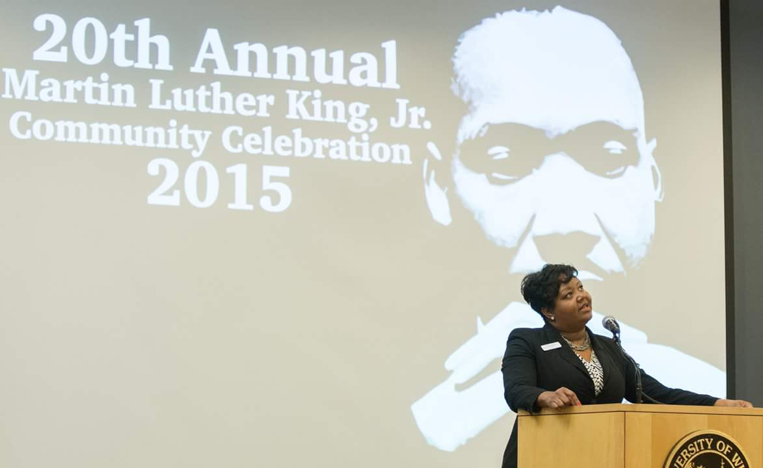
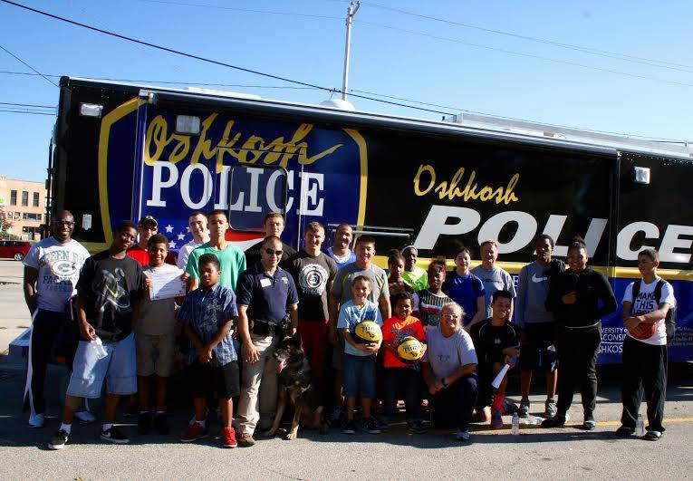
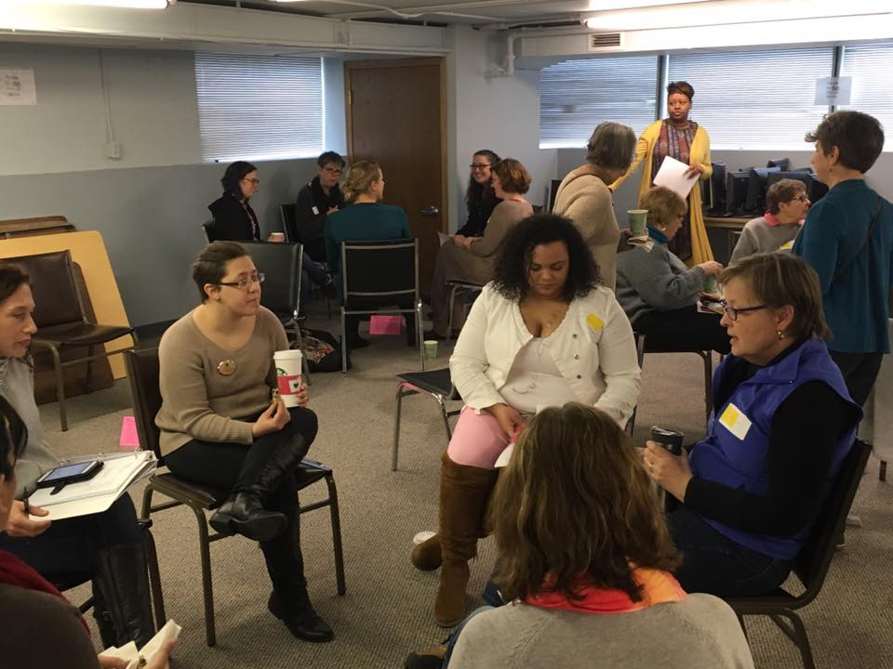
To promote social transformation through Color-Brave conversations, education, advocacy, and research in order to achieve race equity and justice within our community.

Slide 11
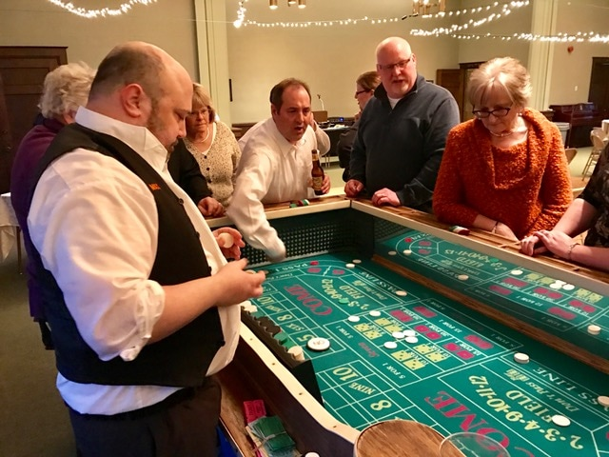
^{Pastoral Care and} ^{Fellowship}
“Blessed be the God and Father of our Lord Jesus Christ, the Father of mercies and the God of all consolation, who consoles us in all our affliction, so that we may be able to console those who are in any affliction with the consolation with which we ourselves are consoled by God” 2 Corinthians 1:3-4
What are we doing now?
What needs/opportunities
have we identified?

Slide 12
Fellowship Survey
Parish Picnic | 39
Spirituality Event | 28
Potluck Dinner/Sunday Brunch | 26
Movie Night | 21
Progressive Dinner | 20
Game Night | 16
Theater Party | 12

Slide 13
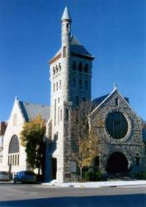
^{Ministry to/with Older People}
“Even to your old age I am he. Even when you turn grey I will carry you. I have made, and I will bear; I will carry and will save.” Isaiah 46:4
What are we doing now?
What needs/opportunities
have we identified?

Slide 14
Statistics within Oshkosh (2010 census):
13% of Oshkosh population are seniors (65+ years of age)
44% of females are widowed; 19% of males are widowed
35% of seniors live alone; of those, 75% are female
69% of seniors continue to live in their own home
7% have an annual income less than $10K (below the poverty line)
28% have an annual income less than $20K
15% of residents over the age of 60 received food stamps last year
37% of people think they will need long-term care; 69% actually will need long-term care

Slide 15
Worries/Challenges Older People Face:
Maintaining good health Healthcare costs
False confidence Disease
Staying in own home Physical aging
Giving up driving Physical assistance
Financial security Financial security
Sudden bills Loneliness
Cutting costs Financial predators
Social ties Abuse or neglect
Mental health Transportation
Social support Changing social climate

Slide 16
In our parish, what are some of the challenges/worries?
Loss: of family, friends, health, independence
Inability to do simple, ordinary tasks
Keeping up with the house and yard; making the house safer
Health concerns: memory loss, vision/hearing loss, loss of mobility
Transportation
Relationships with family members
Making decisions
Not wanting to be a bother; hesitant to ask for help (especially from their children)
Finding time to do everything
Meeting new friends

Slide 17
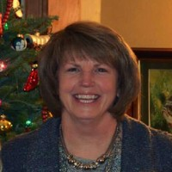
Social isolation - especially following the death of a spouse or when people continue to live at home but are no longer able to drive or get out much
Assistance that enables them to continue living at home as long as possible, which would include things like help with grocery shopping, yard work, and small home maintenance projects and repairs.
Oshkosh neighborhood associations
Habitat for Humanity's 'Rock the Block' initiative, which is trying to address the home maintenance/repair needs

Slide 18
In what ways could Trinity be more present/helpful?
Pastoral visits from clergy and fellow parishioners
Assistance for those who want to stay in their homes: both discussion and help either with staying or downsizing
Transportation to church
Improvements to the sound system at church
Padding for the pews
Contact and conversation about church life and decisions

Slide 19
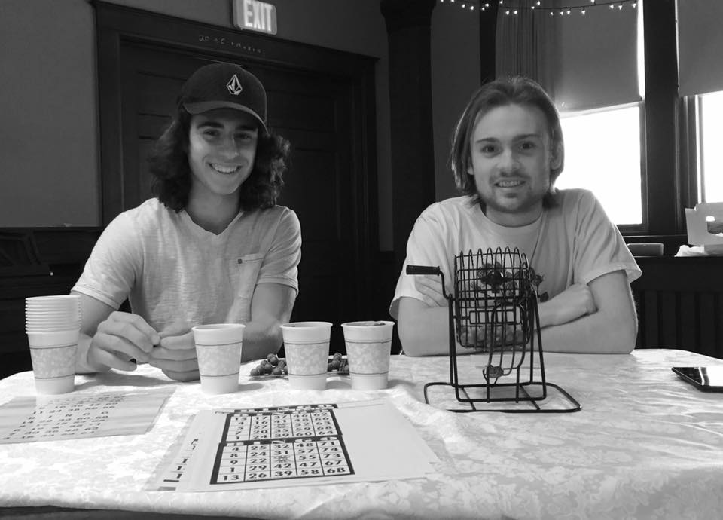
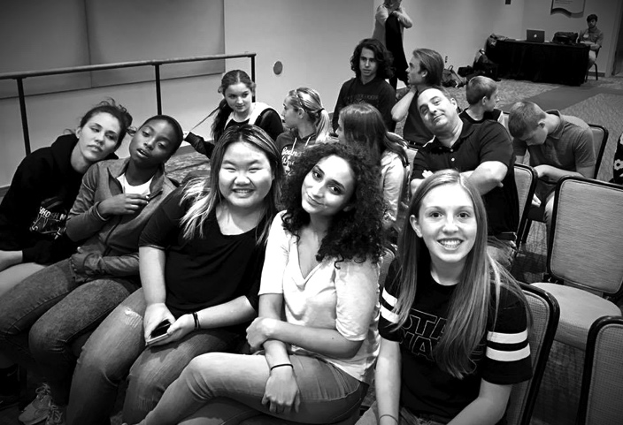
^{Youth}
“Let no one despise your youth, but set the believers an example in speech and conduct, in love, in faith, in purity.” 1 Timothy 4:12
What are we doing now?
What needs/opportunities have we identified?

Slide 20
Table
Discussions

Slide 21
What is the Holy Spirit calling us to do?
Where are our gifts and passion?

Slide 22
The next vestry meeting will take place on September 20
at 6:30 PM.
The meetings are open, and everyone is welcome to attend.

